Slide 1
Measure of metrics – IV
Community Detection
MA 653: Network Science
Instructor: Ashok Singh Sairam
ashok@iitg.ac.in

Slide 2
What is a community?
A community in a network is a subset of nodes that share common or similar characteristics, based on which they are grouped.
In a social network it might indicate a circle of friends,
In the WWW it might indicate a group of pages on closely related topics,
In a network of emails it may indicate groups of emails that have similar patterns or domain or belong to individuals that correspond on a regular basis.
Community detection: partitioning the nodes into communities

Slide 3
Groups of vertices (Social Cohesion)
Networks such as social networks, divide naturally into group/communities
Example: friends, co-workers, or business partners
Objective: Find a meaningful way to separate large networks into groups
That reduces overlap
Locate cohesive group

Slide 4
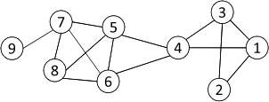
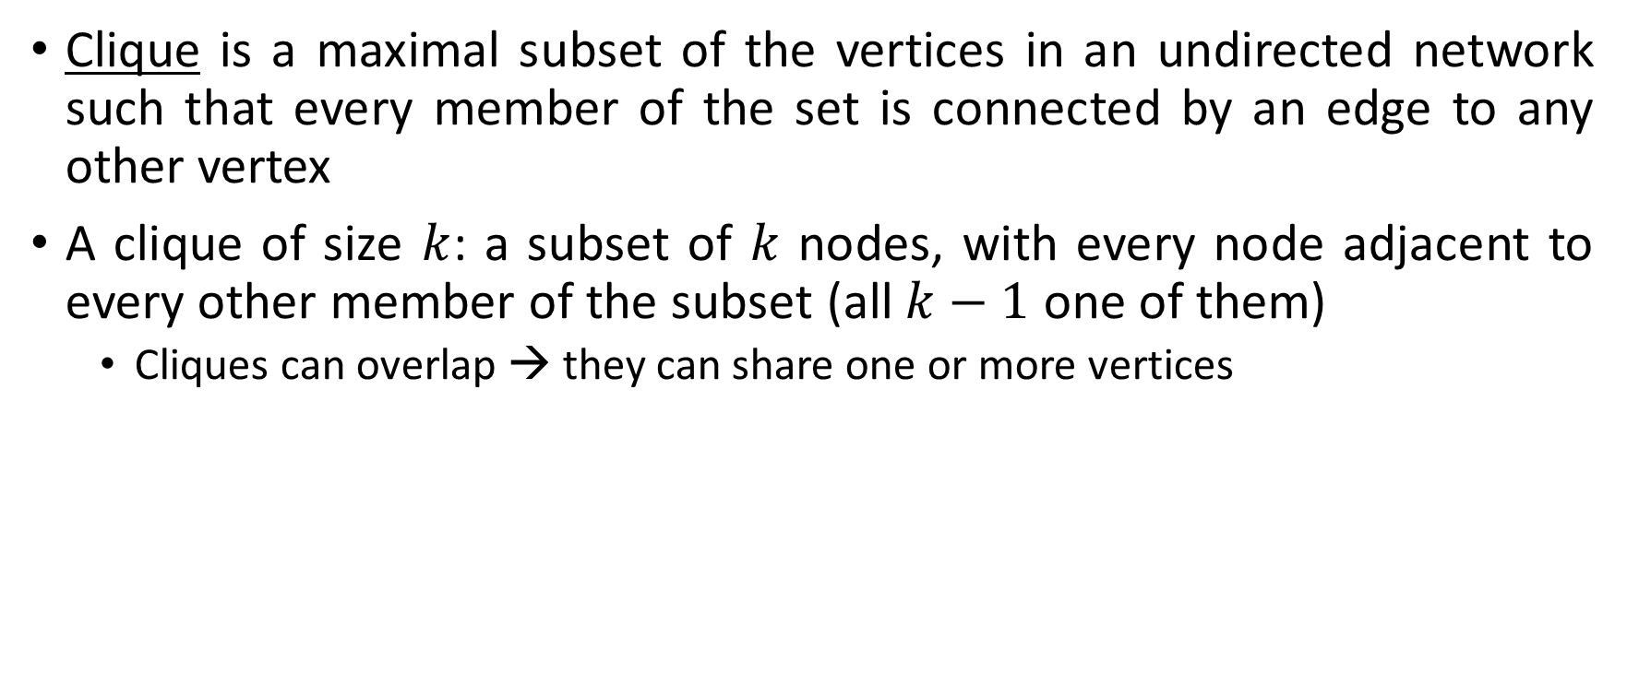
Clique
Clique is a maximal subset of the vertices in an undirected network such that every member of the set is connected by an edge to any other vertex
A clique of size $k$: a subset of $k$ nodes, with every node adjacent to every other member of the subset (all $k−1$ one of them)
Cliques can overlap → they can share one or more vertices

Slide 5
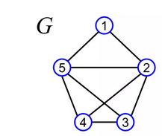
Clique: basics
A clique is said to be
maximal, if it is not a subset of any larger clique
maximum, if there is no larger clique in the graph
Maximal clique: {1, 2, 5}
Is 2,3,4,5 also a maximal clique?
Maximum clique: {2, 3, 4, 5}
How to find the cliques in a network?

Slide 6
Clique Percolation Method (CPM)
Normally use cliques as a core or a seed to find larger communities
Clique Percolation Method to find overlapping communities (diagram on next page)
Input
A parameter k, and a network
Procedure
Find out all cliques of size k in a given network
Construct a clique graph: two cliques are adjacent if they share k-1 nodes
The nodes depicted in the labels of each connected components in the clique graph form a community

Slide 7
Ex: CPM
Parameter = 3
Cliques of size 3:
{1, 2, 3}, {1, 3, 4}, {4, 5, 6}, {5, 6, 7}, {5, 6, 8}, {5, 7, 8},
{6, 7, 8}

Slide 8
Clique: significance
A clique in an otherwise sparse network, indicates a highly cohesive subgroup
The requirement of being connected to all other members is strict
In real networks, people might be connected to most but not all of their acquaintances
A relaxed version of a clique might be just as useful in large networks.
NP-hard to find the maximum clique in a network
Straightforward implementation to find cliques is very expensive in time complexity

Slide 9
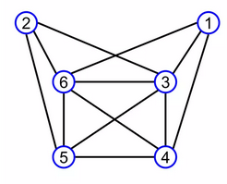
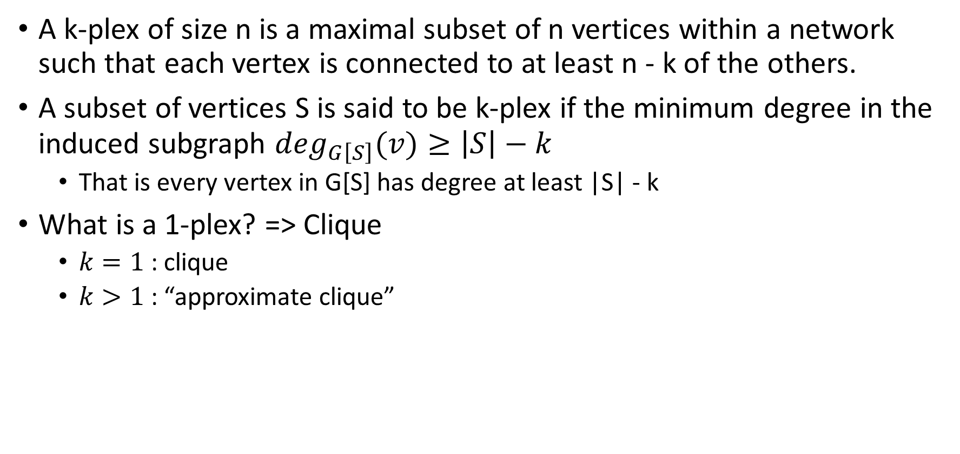
k-plex
A k-plex of size n is a maximal subset of n vertices within a network such that each vertex is connected to at least n - k of the others.
A subset of vertices S is said to be k-plex if the minimum degree in the induced subgraph $\deg_{G\left[S\right]}(v)≥\left|S\right|−k$
That is every vertex in G[S] has degree at least |S| - k
What is a 1-plex? => Clique
$k=1$: clique
$k>1$: “approximate clique”
{3, 4, 5, 6} is a 1-plex, the regular clique
{1, 3, 4, 5, 6} is a 2-plex
{1, 2, 3, 4, 5, 6} is a 3-plex

Slide 10
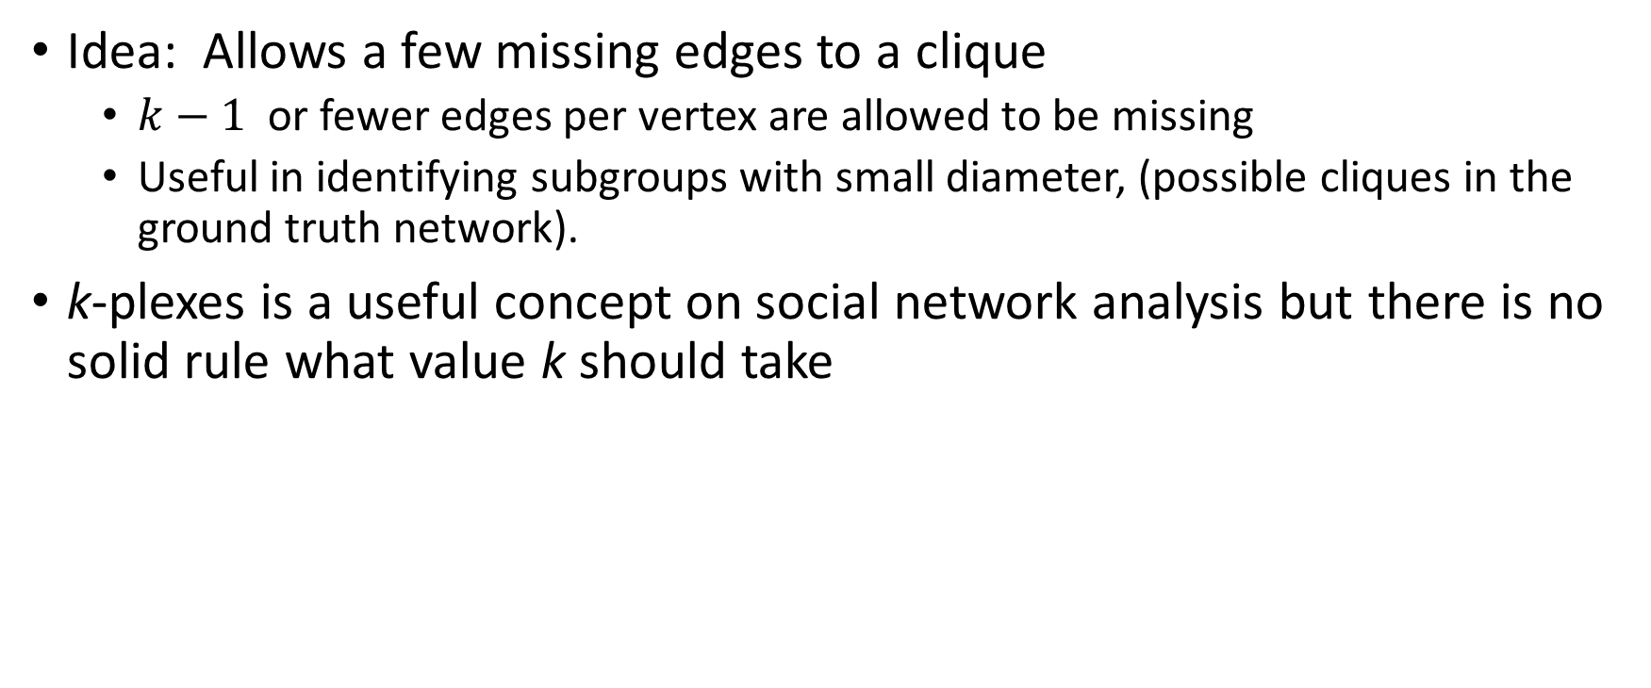
k-plex: significance
Idea: Allows a few missing edges to a clique
$k−1$ or fewer edges per vertex are allowed to be missing
Useful in identifying subgroups with small diameter, (possible cliques in the ground truth network).
k-plexes is a useful concept on social network analysis but there is no solid rule what value k should take

Slide 11
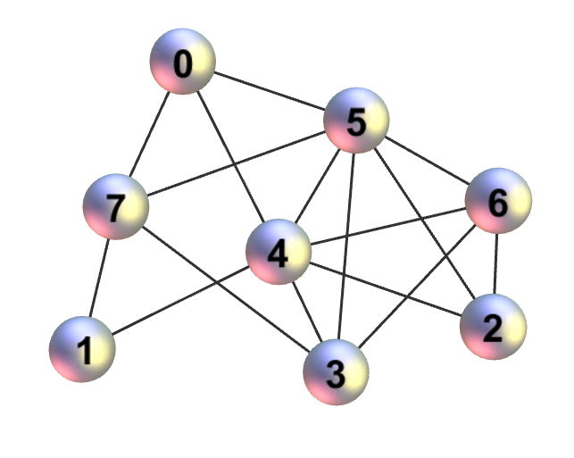
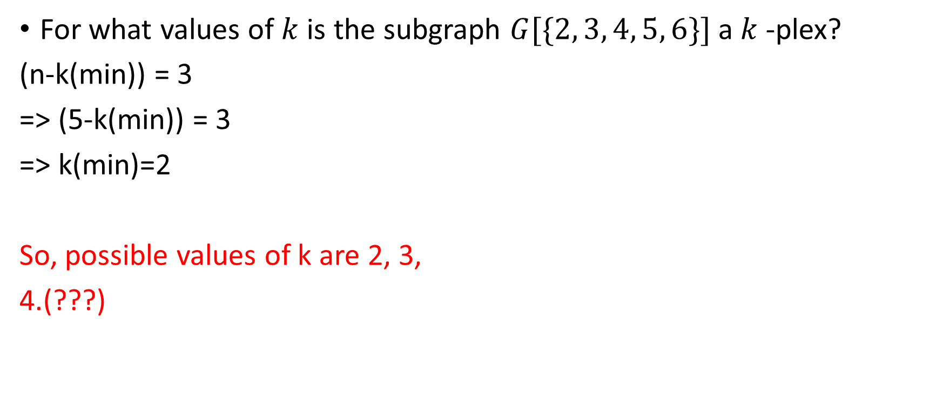
Example: k-plex
For what values of $k$ is the subgraph $G[\{2, 3, 4, 5, 6\}]$ a $k$-plex?
(n-k(min)) = 3
=> (5-k(min)) = 3
=> k(min)=2
So, possible values of k are 2, 3,
4.(???)

Slide 12
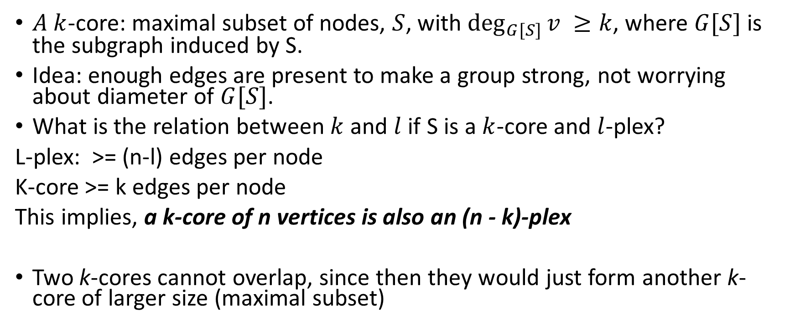
k-core
$A k$-core: maximal subset of nodes, $S$, with $\deg_{G[S]}{v ≥k}$, where $G[S]$ is the subgraph induced by S.
Idea: enough edges are present to make a group strong, not worrying about diameter of $G[S]$.
What is the relation between $k$ and $l$ if S is a $k$-core and $l$-plex?
L-plex: >= (n-l) edges per node
K-core >= k edges per node
This implies, a k-core of n vertices is also an (n - k)-plex
Two k-cores cannot overlap, since then they would just form another k-core of larger size (maximal subset)

Slide 13
How to find k-core?
k-cores are of particular interest since there are straightforward algorithms to compute k-cores in a network:
Start by removing from the network nodes of degree < k
Remove also edges of these nodes → update the degrees of nodes that remained after pruning
Continue this process iteratively until you cannot remove any other nodes
The remaining nodes form one or more k-cores
The resulting k-cores might not be connected, regardless if the network we started with was connected or not

Slide 14
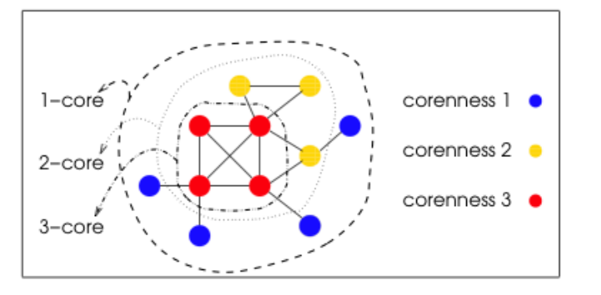
k-core decomposition
No k-cores can exist, when k exceeds the highest degree of G
k-cores have the property of being nested

Slide 15
Review
Ex: 7.9(a)Find a 3-core in these two networks or state that there is none:
=> Whole graph is a 3-core.
=> There is no 3-core (can be proved using the algorithm given on previous slide)

Slide 16
Recap: Component
A component in an undirected graph is a maximal set of vertices such that each is reachable by some path from each of the others
In directed graph, a strongly connected component is a maximal set of vertices such that there is a directed path in both directions between every pair of vertices

Slide 17
Ex: Strongly connected component
Ex 7.9(b) Find all the strongly connected components in this graph:
{B, C}, {E, F, I, H}
B
C
A
D
E
F
G
H
I

Slide 18
k-components
A k-component is a maximal subset of vertices such that each is reachable from each of the others by at least k vertex-independent paths
For k=2 → bicomponents and for k=3 → tricomponents
A k-component is a subset of a (k-1)-component

Slide 19
k-core vs. k-component
Examine the graph given below
Consider it as a k-core network, what is the value of k? k = 2 (and 1 as well(???))
How many types of k-component is present? => 1-component only, if whole graph is considered.

Slide 20
k-components
k-components are tightly related to the notion of network robustness
This means k-vertex independent paths
This means k-min cutset
For k > 2 the k-components need not be contiguous
In social network sciences, non-contiguous components are not desirable
A more strict definition comes from the
requirement that the paths should be entirely
within the subset

Slide 21
How to find the k-components?
Menger’s theorem: The size of the minimum vertex cut set is equal to the number of independent paths between the same nodes
This theorem allows us to find the min cut set by determining the maximum independent paths, which is much easier.
Thus, to find k-components (k-minimum cutset) we need to find k-independent paths
Finding independent paths is much easier
The Ford-Fulkerson or Augmenting path algorithm is most widely used

Slide 22
Basic idea:
First, find a path from A to target B using BFS
Assume all edges have weight 1
Find another path from the remaining edges
Repeat the process until no more new paths can be found
W
X
A
B
Y
Z
the algorithm may not always find the maximum flow, if we choose the wrong edges

Slide 23
Augmenting Path Algorithm (2)
Fix: Allow fluid to flow both ways
If fluid flow both ways, they will cancel out each other. The net flow will be zero
W
X
First Path
A
B
Second Path
Y
Z

